Slide 1


Topic : Fake social media accounts and their detections _{Domain : Cyber Security} _{Team ID : T060} _{Team name :} Syntax Squad Team members : Saiprasanna (2303A51355) _{Madhuri (2303A51295)} _{Srivarsha (2303A51337)} _{Nirnaya (2303A51060)} _{Rashmitha (2303A51343)}

Slide 2

Objective
Purpose of the Project :
Detect and Remove Fake Accounts to stop scams and identity theft.
Central Team to track and report fake accounts.
Protect Users and Organizations from online threats.
Expected Outcomes :
Quick detection and removal of fake accounts.
Improved online security for everyone.

Slide 3
Problem Statement
Issue :
Fake accounts on social media are growing rapidly, causing serious problems.
Challenges in the Current System :
Fake accounts are used for fraud,cybercrimes & spreading fake news.
Existing methods for detecting & removing them are slow and ineffective.
There’s no central system to track and take action on these accounts.
Key Pain Points:
Increased risk of scams and crimes.
Lack of coordination between platforms.
Slow response in removing harmful accounts

Slide 4
Existing system Comparsion of current vs New system
FEATURES | CURRENT SYSTEM | NEW SYSTEM
Detection | Manual & slow | AI powered & fast
Tracking | No central system | One agency tracks all
Removal | Fake accounts keep coming back | Quick & permanent for all
Efficiency | Time consuming | Automated & effective
⏳
🚀

Slide 5
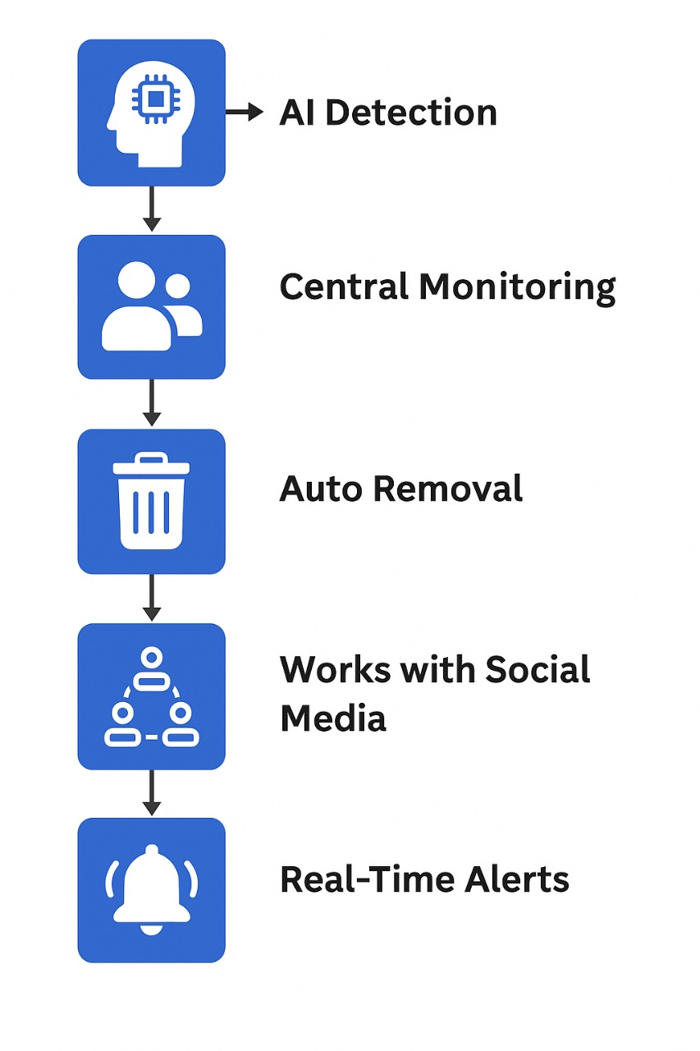
Proposed system
🚀 New System : Smarter Fake Account Detection
An AI-powered system that quickly finds and removes fake social media accounts.
Advantages :
Faster – AI detects fake accounts instantly.
Better Tracking – A central agency monitors fake profiles.
Automatic Removal – No waiting, fake accounts get deleted fast.
Stronger Security – Protects against scams and misinformation.

Slide 6
Workflow
Collect Data [ scaning profiles]
↓
AI Detection [ spot fake accounts]
↓
Verification [ central agency checks]
↓
Report & Action [ Report to social media]
↓
Account Removal [ Delete fake account ]

Slide 7
System Architecture
Collect Data
[ Get user info & reports]
Detect Fake Accounts
[ Use AI & filters ]
Verify Information
[Cross-check with database, Avoid mistakes]
Take Action
[Report or remove accounts]

Slide 8
Conclusion & Future Scope
AI-powered tools and monitoring can quickly detect and remove fake accounts, ensuring online safety.
Future Scope:
Smarter AI for better detection
Real-time monitoring
Global teamwork
Stronger verification systems
Empowering cybersecurity with AI-driven solutions, we pave the way for a trust and free digital space. 🔐🌍🚀

